Slide 1
StudyBook Team 4-2
An academic social network for Mississippi State Students

Slide 2
Overview
Allows students to meet classmates
Encourages and facilitates group studying
Helps students stay on top of a number different of class schedules
Includes easy way to advertise books to future students once the semester is over

Slide 3
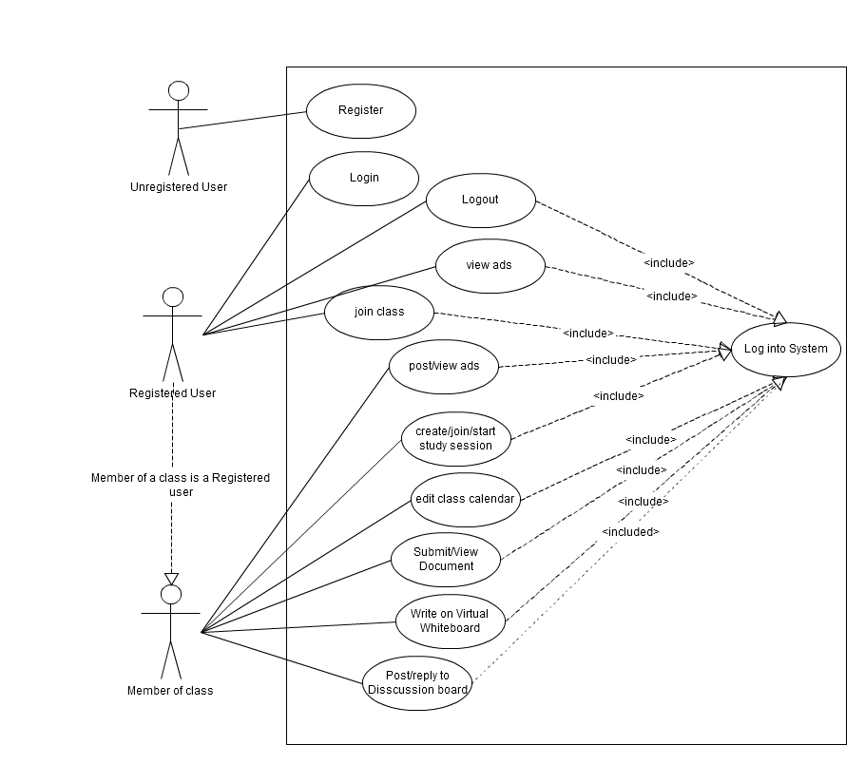
Case Diagram
Notes:
Must be logged in for everything
Really only one type of user

Slide 4
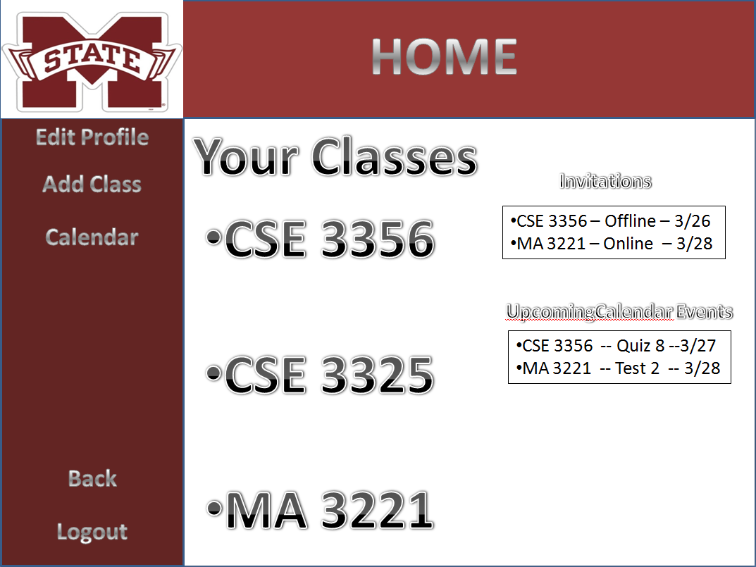
Your Profile
Basic profile with only important information
Single Calendar for all your classes
Links to enrolled classes
Notes:
Basic profile
Study session invitations
Upcoming calendar events like tests and quizes
Link to calendar with info from all classes

Slide 5
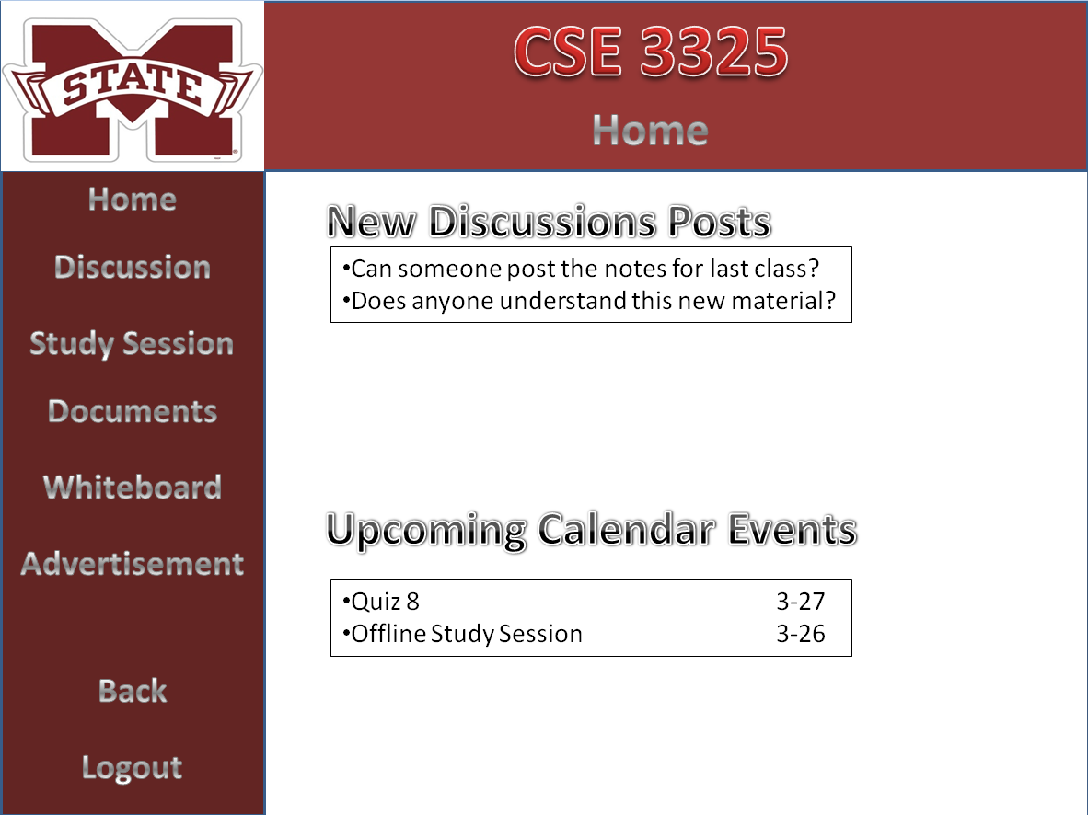
The Class Homepage
Notes:
Shows recent discussion topics with links to them.
Shows upcoming calendar events again with links to more details on them.

Slide 6
Class Calendar
Simple calendar
Students can add and edit events such as Tests to the calendar
Notes:
Basic calendar the students can add to it and edit things such as tests and quizzes and projects
Email or text notifications

Slide 7
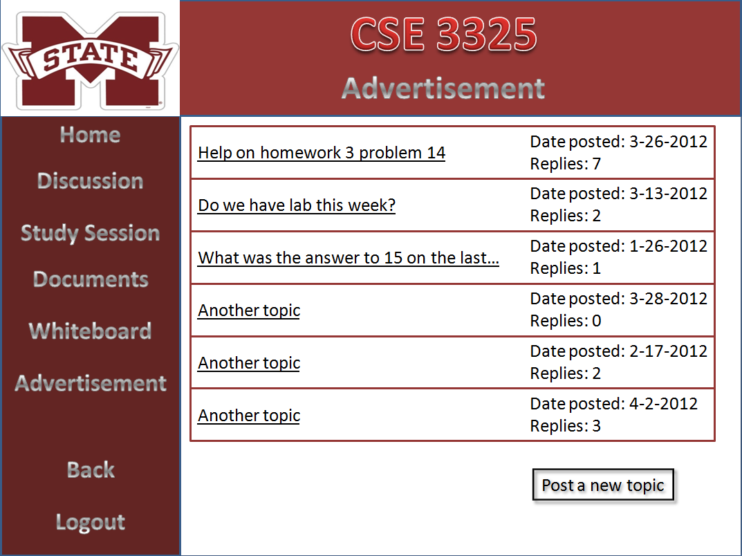


Discussion Board
Users can post new topics and reply to current topics
Used for simple questions that do not need a study session
Notes:
Simple discussion board used main point is for small questions
Can post a new topic and reply to old ones

Slide 8
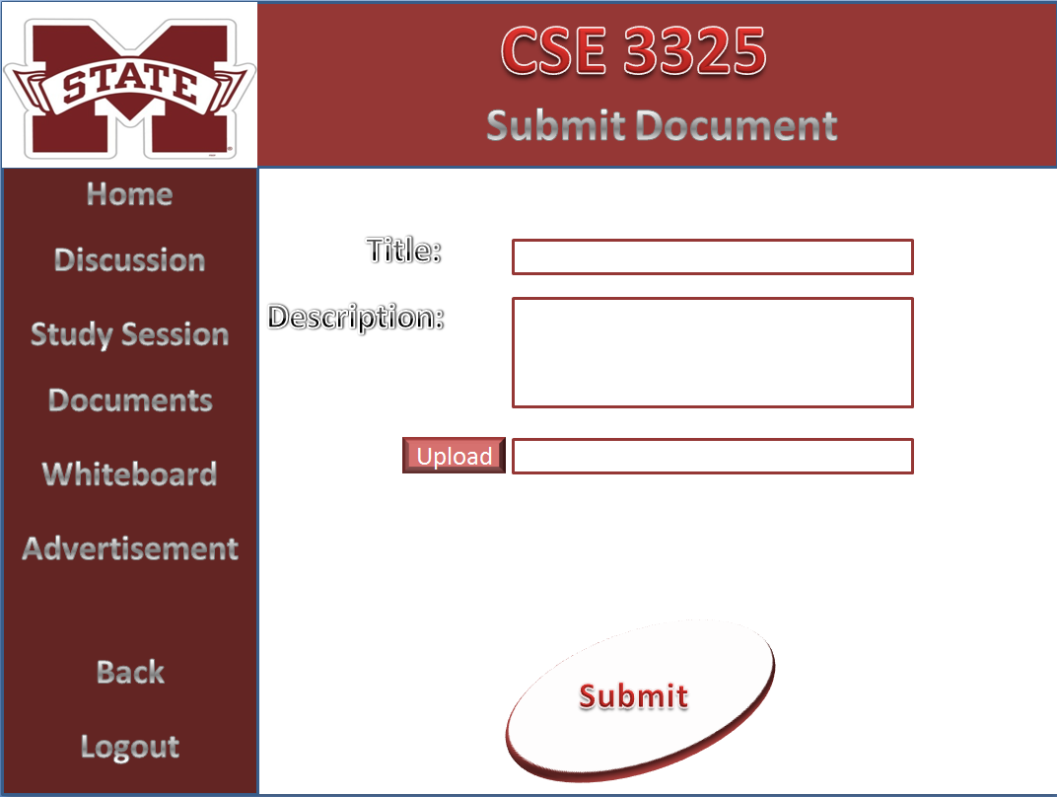
Submitting and Viewing Documents
Notes:
Submit documents mainly notes and study guides or maybe old test so that everyone can be ready for a study session?

Slide 9
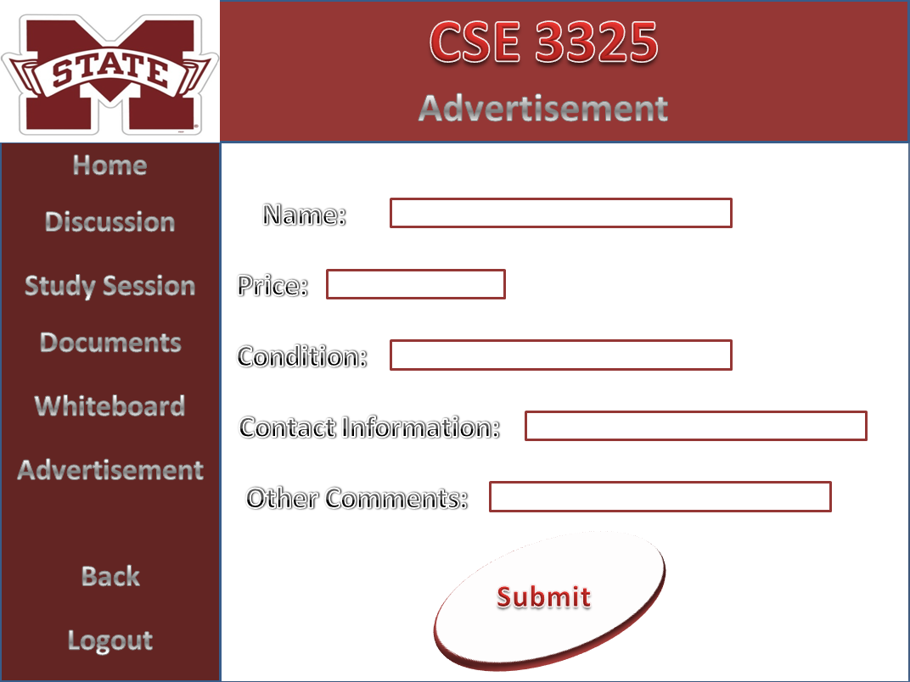
Advertisements
Notes:
Advertise books, lab equipment
Anyone can view the posted ads
No money exchanged through the site

Slide 10
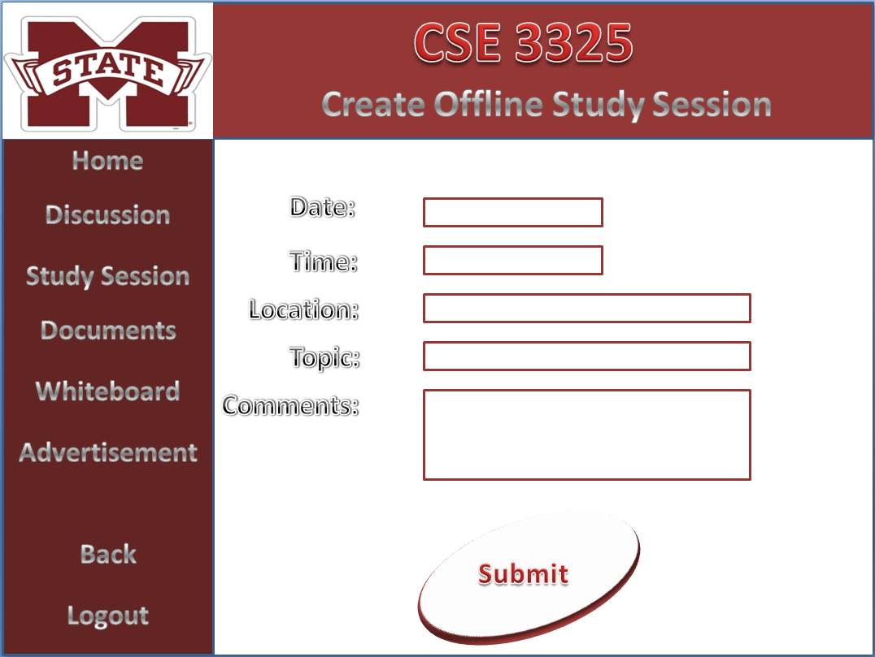
Creating a Study Session
Can be on or offline
Simple form to fill out
All students well get a notification
Notes:
Create a study session, chose online or offline first

Slide 11
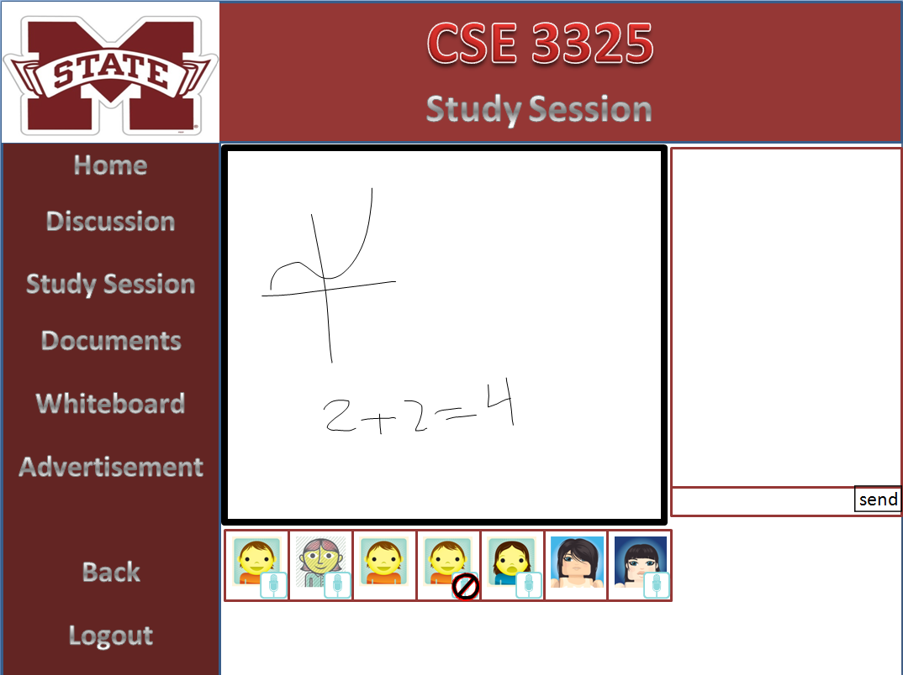
Online Study Session
Virtual whiteboard
Text and voice chat
Notes:
Virtual White board one person at a time, used for drawing things
Voice chat, mute, text chat

Slide 12
Summary
Simple Profile
Discussion Board
Class Specific Calendar
Online/Offline Study Sessions
Submitting and Viewing Documents
Buy and sell used books
Notes:
All student driven

